Slide 1

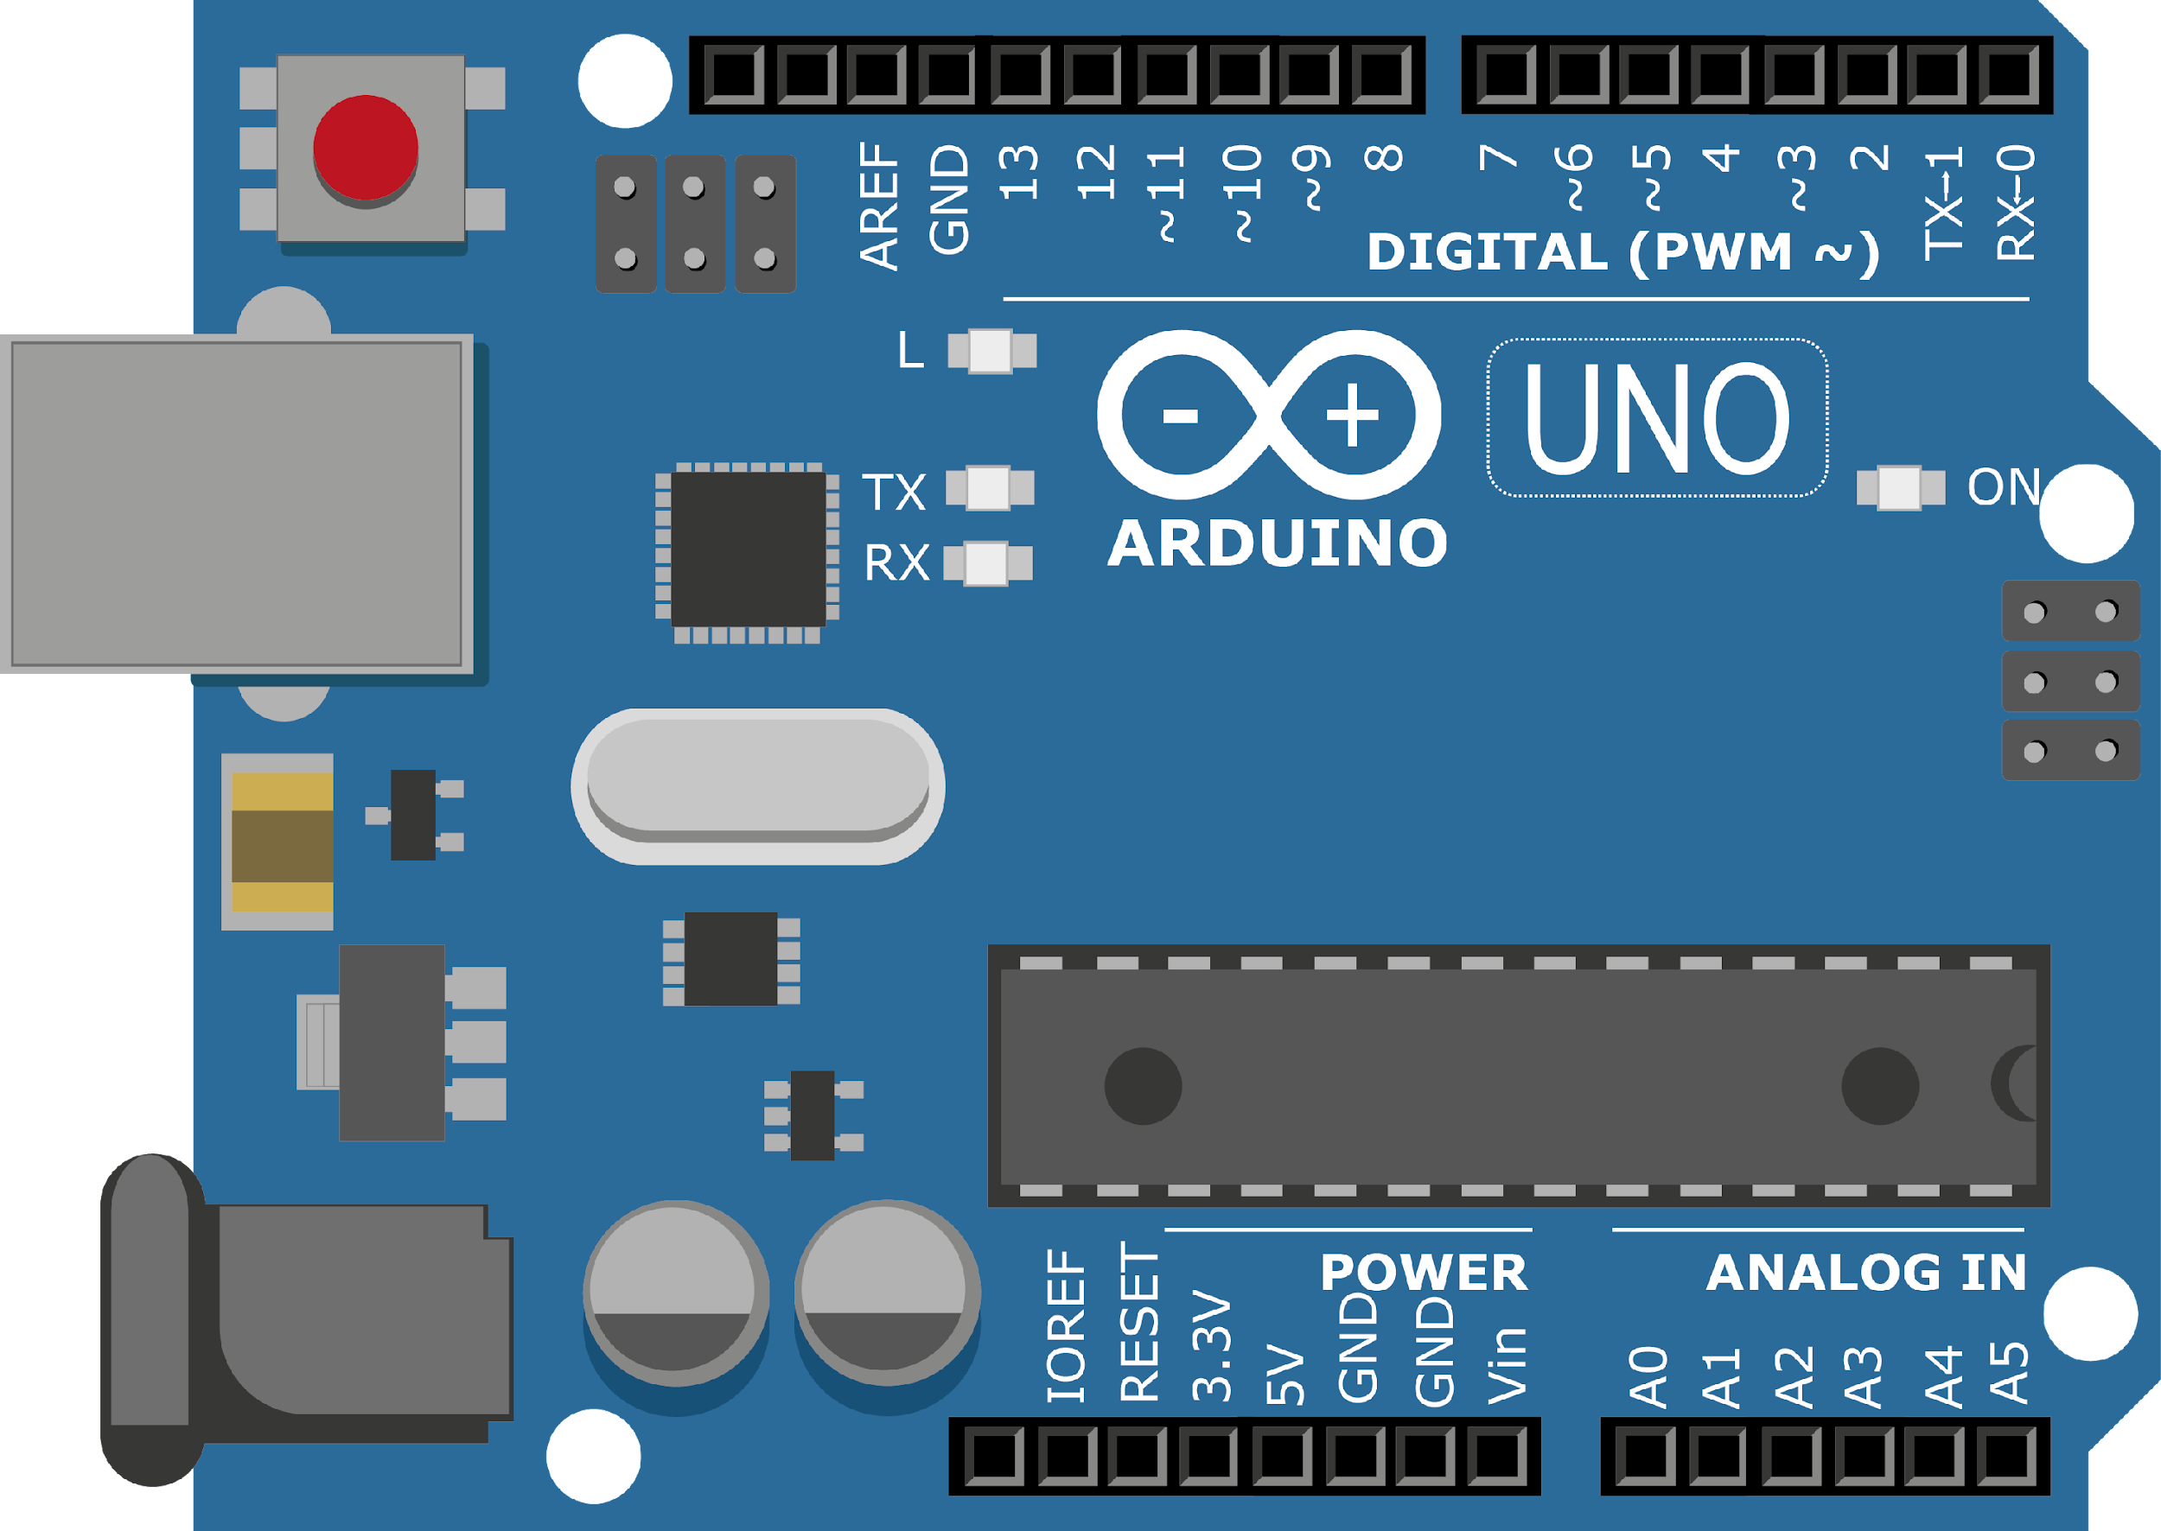
ARDUINO MASTER CLASS
29
Audio Speaker from signal using ADK

Slide 2
29 AGENDA
02
03
01
Signal generator
ADK
Interview questions & News

Slide 3
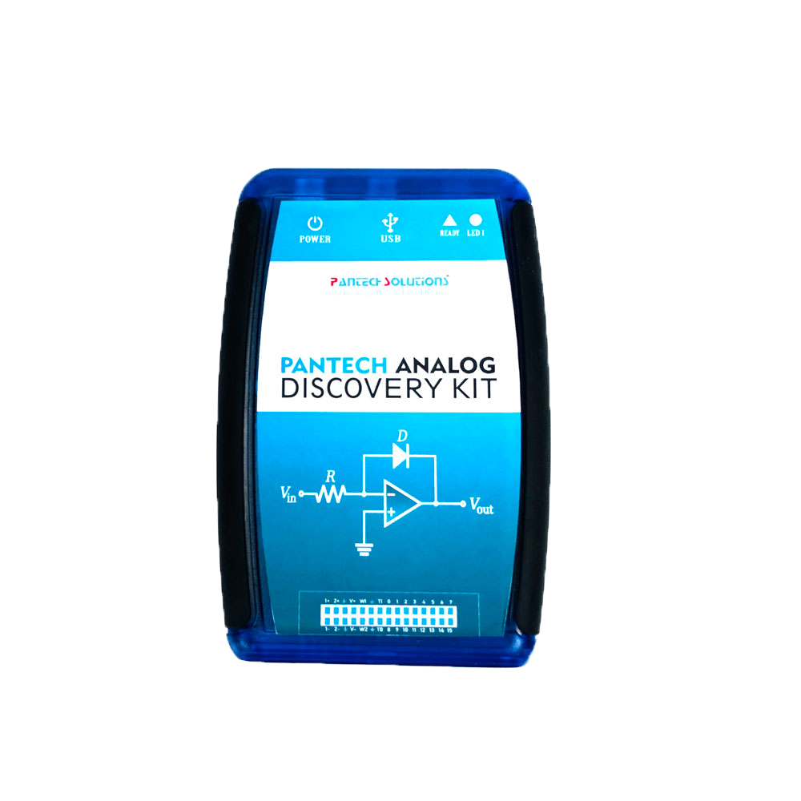
ADK – Analog Discovery Kit
Analog Discovery Kit is a software defined instrument brings the High performance lab equipment in the pocket
This makes every students, hobbyist, researchers and faculties to explore signals and systems, electronic component characteristic studies, protocol analysis etc.
M2k with ADK uses PS SCOPE application in a computer

Slide 4
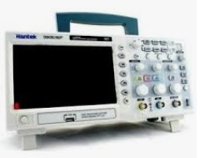
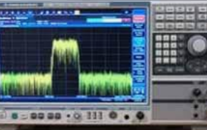
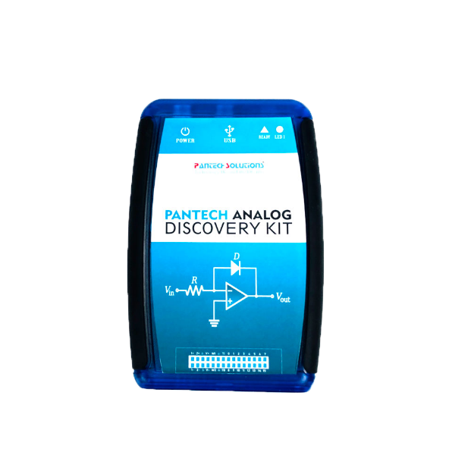
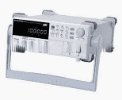
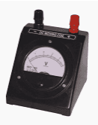
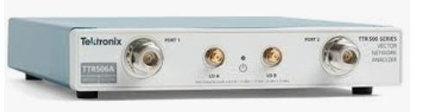
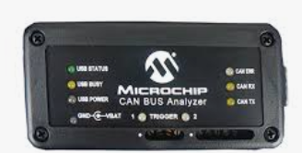
Why do u need ADK? – Portable LAB
Two-channel USB digital oscilloscope
Spectrum Analyzer
Two-channel Function Generator
Single channel Voltmeter
Network Analyzer
Digital Bus Analyzer (SPI,UART & I2C)

Slide 5
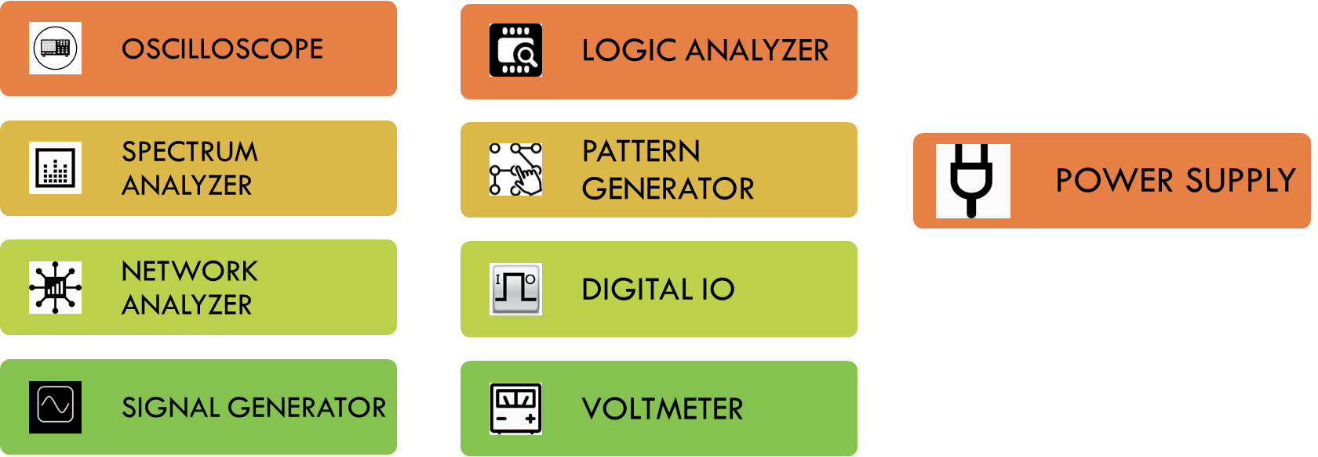
Features of ADK

Slide 6
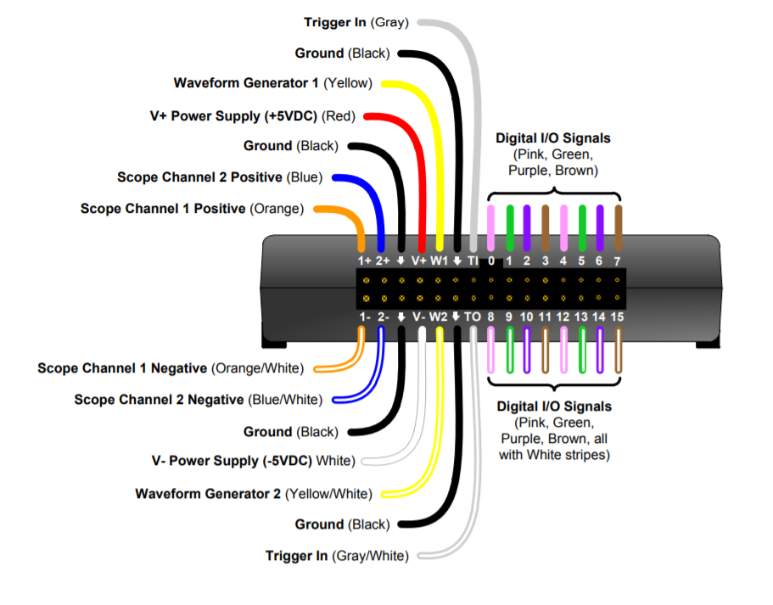
Pinout of ADK

Slide 7

INTERVIEW QUESTIONS
Major Classifications Of The Signal
Spectrum analyzer
How The Analog To Digital Conversion Takes Place
continuous signal
Non continuous signal
periodic signal
Non periodic signal.
A/D conversion takes place in three steps:
sampling
quantization
coding
Spectrum analyzer which displays signal amplitude as it varies by signal frequency

Slide 8

THANKS!

